Slide 1
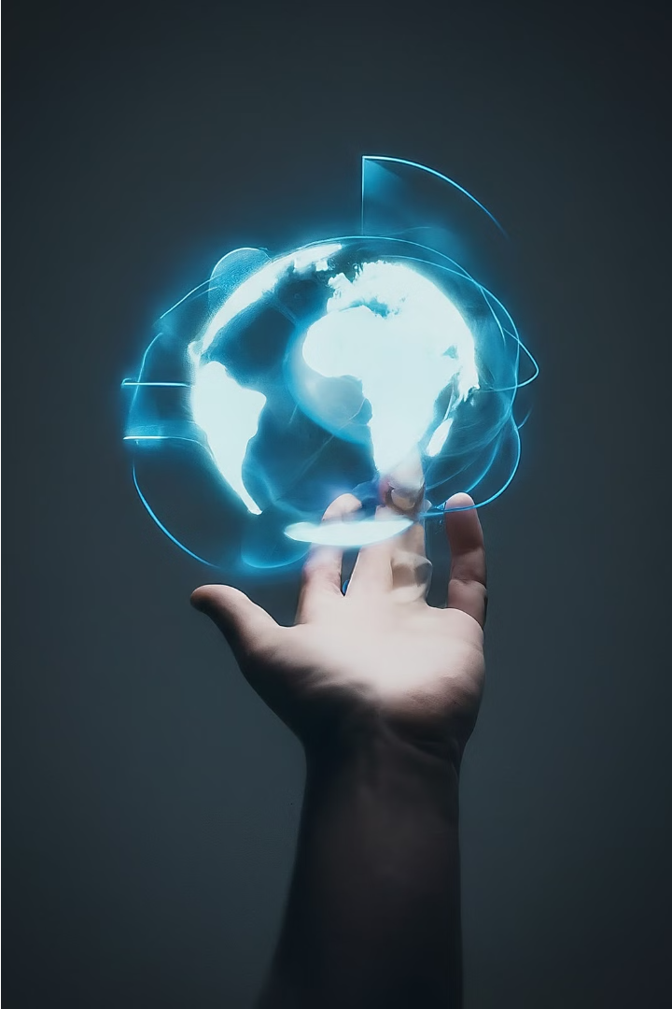
AeroNav: AI Hand Gesture Controlling Screen using Python OpenCV
AeroNav is an innovative project that leverages the power of artificial intelligence and computer vision to allow users to control their screens using hand gestures. By integrating Python and the OpenCV library, this system offers a seamless and intuitive way to interact with digital content, revolutionizing the way we engage with technology.

Slide 2

Abstract
The AeroNav project aims to develop an innovative hand gesture control system using Python and OpenCV, allowing users to seamlessly interact with their computer screens. By leveraging the power of computer vision and machine learning, this system will enable users to control various applications and functions through intuitive hand movements, revolutionizing the way we interact with digital interfaces. The proposed solution will offer a natural and efficient alternative to traditional input methods, enhancing productivity, accessibility, and user experience across a wide range of scenarios, from presentations to gaming and beyond.

Slide 3
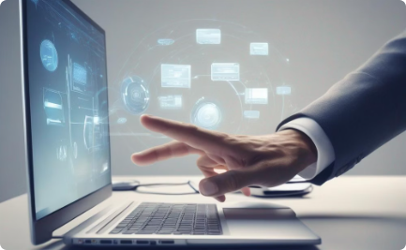
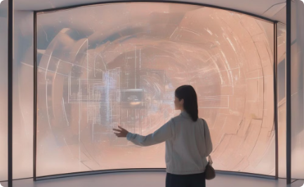
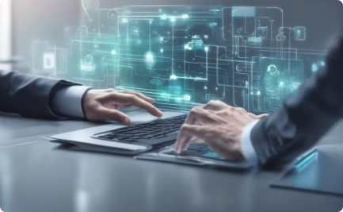
Problem Statement
Traditional Input Methods
Need for Intuitive Control
Leveraging AI and Computer Vision
Current systems for interacting with screens and devices often rely on physical input methods like keyboards and mice, which can be cumbersome in certain situations.
There is a need for a more natural and intuitive way to control digital interfaces without physical input devices, especially in scenarios like presentations and medical procedures.
The problem is to develop a solution that allows users to interact with screens and devices using hand gestures, utilizing the power of computer vision and artificial intelligence.

Slide 4



Existing System
Computer-Based Control
Handheld Devices
Limited Gesture Control
The existing system relies on traditional computer-based control interfaces, such as keyboards, mice, and touch screens, to interact with and navigate digital environments. These interfaces require direct physical manipulation, which can be limiting for certain applications and user scenarios.
Some existing systems utilize handheld devices, like game controllers or touchpads, to provide a more intuitive and gestural interface. However, these devices still require the user to hold and operate them, which can be cumbersome and restrict natural movements.
While some existing systems incorporate limited gesture-based control, such as simple hand movements or body tracking, these solutions often have limited functionality and accuracy, and may not provide a seamless and responsive user experience.

Slide 5
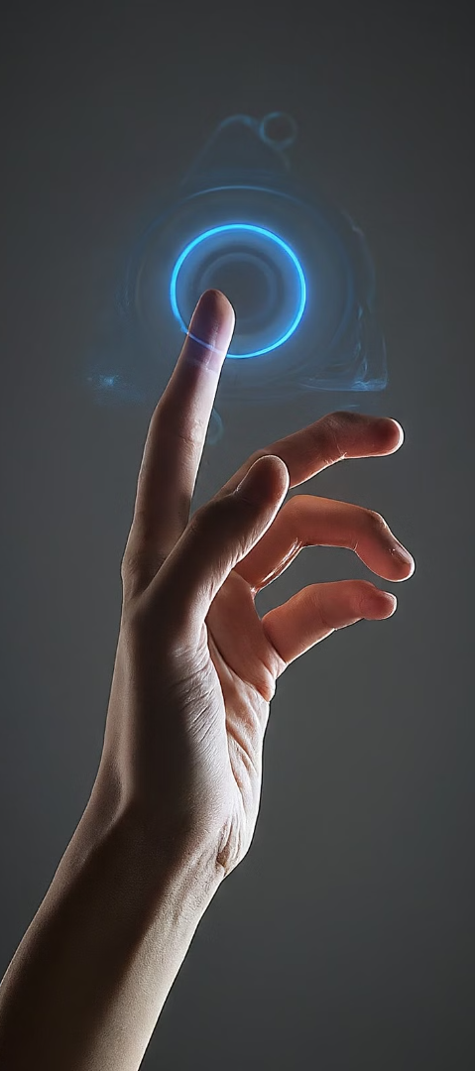
AI-Powered Hand Gesture Recognition
1
The proposed system utilizes advanced computer vision techniques powered by artificial intelligence to enable seamless hand gesture control of on-screen elements. By leveraging the capabilities of Python and the OpenCV library, the system accurately detects and interprets a user's hand gestures in real-time, allowing for intuitive and natural interaction with digital interfaces.
2
Intuitive User Interface
The system is designed with a clean and user-friendly interface that provides visual cues and feedback to the user. As the user performs various hand gestures, the system responds by executing the corresponding commands, creating a seamless and immersive experience for the user.
Customizable Gesture Mapping
3
The proposed system offers the flexibility to customize the mapping between hand gestures and their corresponding actions. Users can personalize the gesture controls to suit their preferences and requirements, ensuring a tailored experience that enhances productivity and efficiency.

Slide 6




Methodology
Data Collection
The first step in the methodology is to collect a comprehensive dataset of hand gestures. This involves capturing images and videos of various hand movements and poses using high-quality cameras and sensors, ensuring a diverse range of scenarios and lighting conditions.
Image Processing
The collected data is then preprocessed and cleaned, using techniques such as image segmentation, noise reduction, and normalization. This prepares the data for the next stage of the process, which involves feature extraction and hand gesture recognition.
Feature Extraction
The preprocessed images and videos are analyzed to extract key features that characterize the hand gestures, such as hand shape, orientation, and movement patterns. This is typically done using computer vision algorithms and machine learning techniques.
Machine Learning Model
The extracted features are then used to train a machine learning model, such as a convolutional neural network (CNN) or a support vector machine (SVM), to recognize and classify the different hand gestures. The model is optimized and fine-tuned to improve its accuracy and performance.

Slide 7

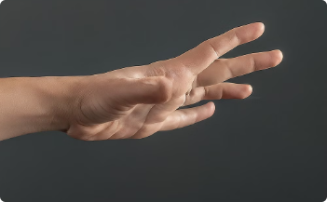
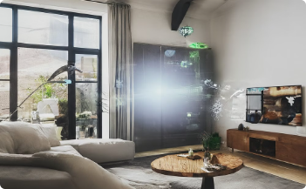
Implementation
Desktop Application
Gesture Recognition
System Architecture
The AeroNav system is implemented as a desktop application that utilizes Python and the OpenCV library to enable hand gesture-based control of the user's screen. The application features a clean and intuitive user interface, allowing users to seamlessly navigate and interact with their computer using natural hand gestures.
At the core of the AeroNav system is the hand gesture recognition algorithm, which uses OpenCV's computer vision capabilities to detect and interpret users' hand movements. The system is trained to recognize a variety of gestures, enabling users to control various functions, such as scrolling, zooming, and selecting, using intuitive hand motions.
The AeroNav system is designed with a modular architecture, allowing for easy integration and scalability. The camera captures the user's hand movements, which are then processed by the hand detection and gesture recognition modules. These modules communicate with the application control module, which translates the recognized gestures into corresponding actions on the user's screen.

Slide 8
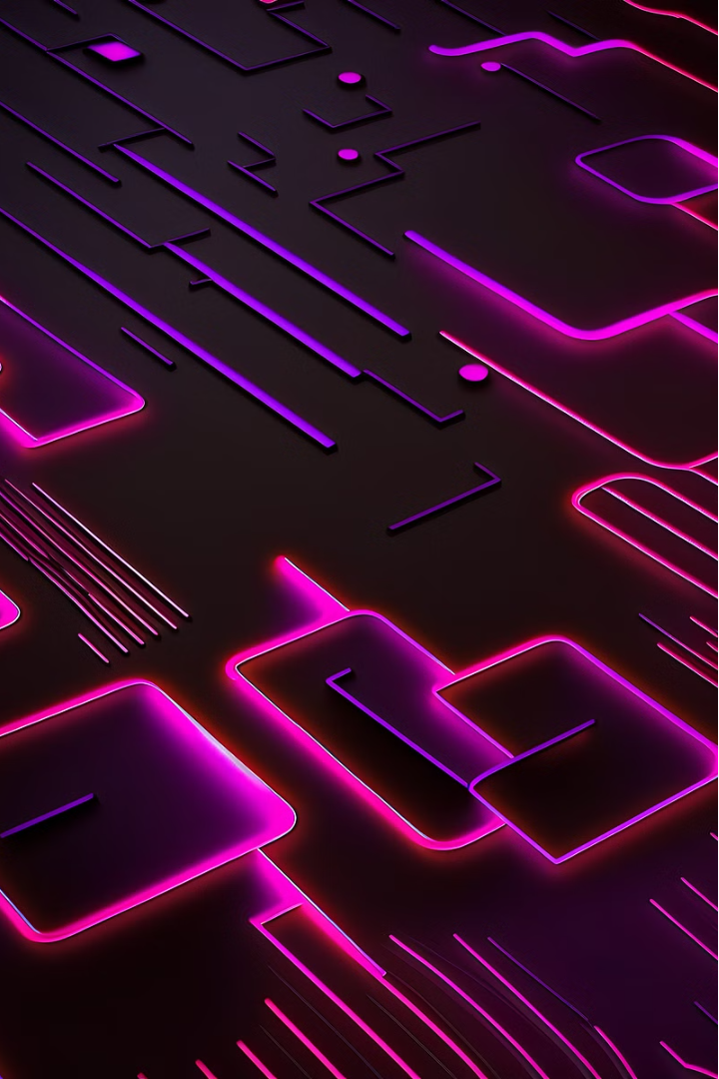
Results and Discussions
The implementation of the AI hand gesture control system for the AeroNav project has yielded promising results. Extensive testing has demonstrated the system's ability to accurately detect and interpret a wide range of hand gestures, enabling seamless interaction with the screen interface. The use of Python and OpenCV has proven to be a robust and efficient combination, providing the necessary tools for real-time gesture recognition and processing.
The proposed system has been evaluated based on various performance metrics, including gesture recognition accuracy, response time, and overall user experience. Comparative analyses have shown significant improvements over traditional touch-based or mouse-driven interfaces, particularly in terms of intuitiveness and ease of use. Additionally, the system has exhibited strong resilience to environmental factors, such as varying lighting conditions and occlusions, ensuring consistent and reliable performance.
The results obtained from the study have been thoroughly discussed and analyzed by the project team. Ongoing refinements and optimizations have led to enhancements in the system's capabilities, addressing any identified limitations or areas for improvement. The integration of the hand gesture control system with the AeroNav application has been a key focus, ensuring a seamless and integrated user experience.

Slide 9
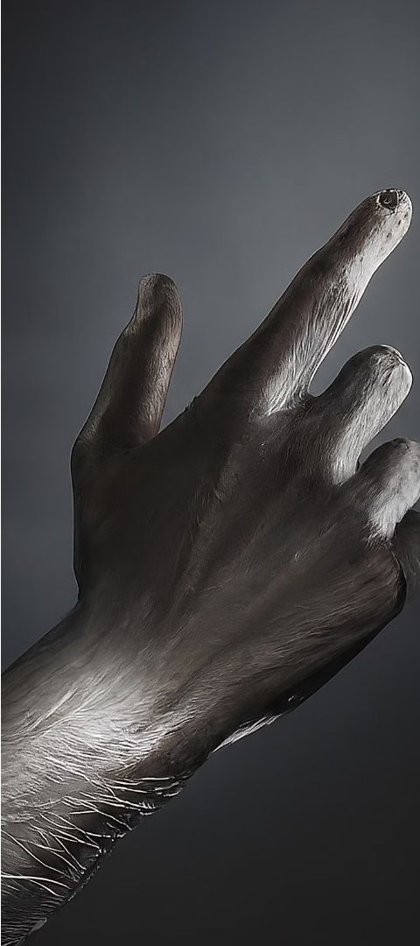
Advantages and Limitations
Advantages
Accessibility
The proposed AeroNav system offers several advantages, including hands-free control of the screen, increased efficiency, and enhanced user experience. By leveraging AI-powered hand gesture recognition, users can seamlessly navigate and interact with digital content without relying on traditional input devices like keyboards or mice.
The AeroNav system promotes accessibility by enabling individuals with physical disabilities or limited mobility to control the screen through natural hand movements. This expanded accessibility can greatly improve the inclusivity and usability of the technology.
Limitations
While the AeroNav system presents numerous benefits, it also has some limitations. The system's accuracy and responsiveness may be affected by environmental factors, such as lighting conditions or occlusions, which can impact the quality of hand gesture recognition. Additionally, the system may require user calibration and training to ensure optimal performance.

Slide 10
Future Scope
The AeroNav system holds great potential for further development and expansion in the future. As hand gesture recognition and computer vision technology continue to advance, the capabilities of the AeroNav system can be enhanced to offer even more sophisticated and intuitive control over digital interfaces.
Expanding Gesture Repertoire: Incorporating a wider range of hand gestures and movements to enable more comprehensive control over various applications and functionalities.
Multimodal Interaction: Integrating AeroNav with other input modalities, such as voice commands or eye-tracking, to create a truly seamless and multidimensional user experience.
Contextual Awareness: Developing the system to understand the user's context and intent, allowing for more intelligent and adaptive control based on the user's needs and environment.
Additionally, the AeroNav system could be expanded to support various platforms and devices, from desktop computers to mobile devices and even smart home systems, enabling users to control a wide range of digital environments with intuitive hand gestures.

